Slide 1


Presented By- Vishant Kumar
Assistant Professor
Computer Science & Engineering Department
Tula’s Institute, Dehradun

Slide 2
What is a Computer?
➢Computer is a machine which can perform many tasks.
➢It was originally invented to do speedy and accurate calculations, it can be used for other purposes too.
➢It can perform any kind of work involving arithmetic and logical operations on deta,process it as per the instruction or input given and give the information as output.

Slide 3



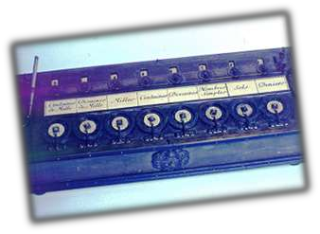
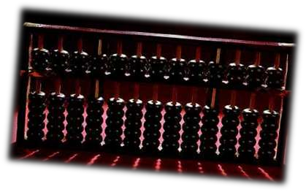

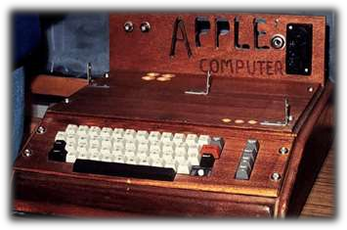
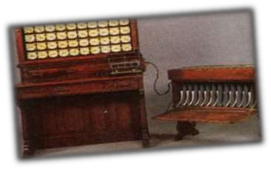
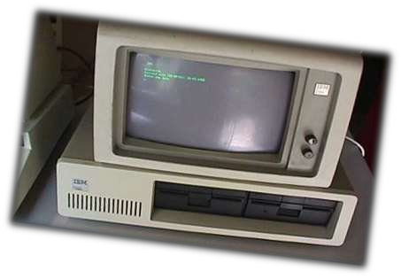
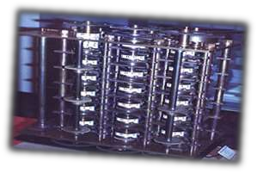
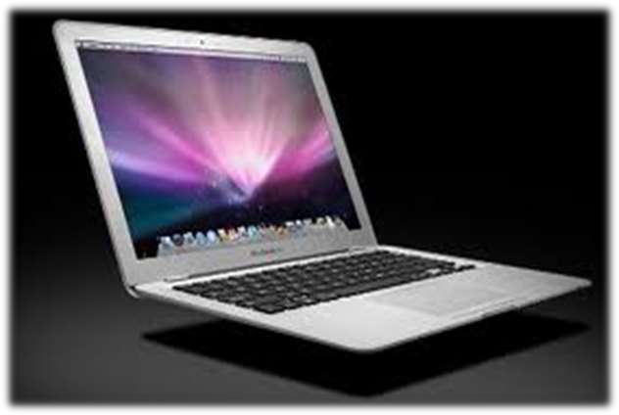
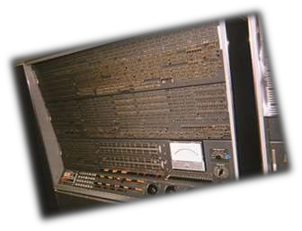
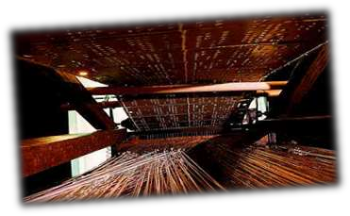
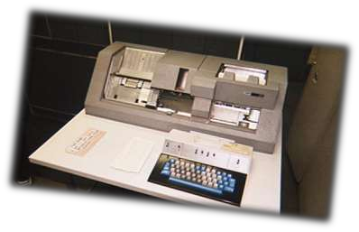
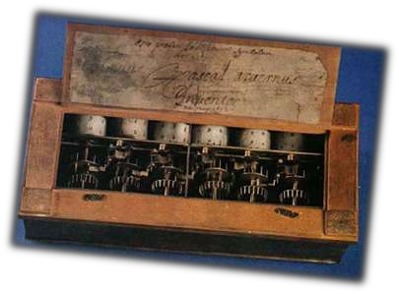
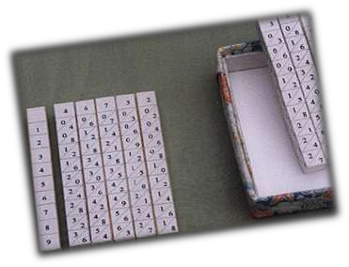
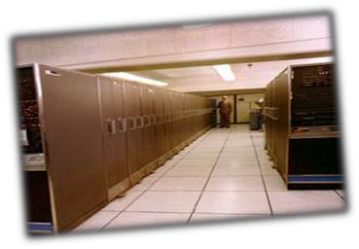

Slide 4
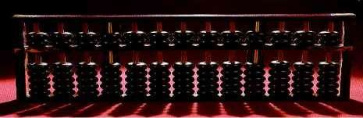
Abacus
The Abacus was an early aid for mathematical computations.
The oldest surviving abacus was used in 300 B.C. by
the Babylonians.
A skilled abacus operator can work on addition and subtraction problems at the speed of a person equipped with a hand calculator.
The abacus is still in use today, principally in the far east.

Slide 5
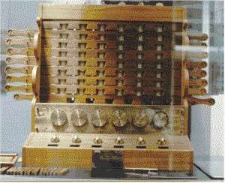
Schickard's Calculating Clock
The first gear-driven calculating machine to actually
be built was probably the calculating clock, so
named by its inventor, the German professor Wilhelm
Schickard in 1623.
This device got little publicity because Schickard died
soon afterward in the bubonic plague.

Slide 6
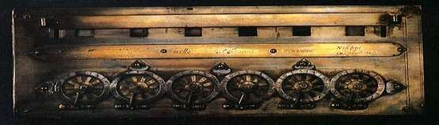
Pascal's Pascaline
In 1642 Blaise Pascal, at age 19, invented the Pascaline as an aid for his father who was a tax
collector.
Up until the present age when car dashboards went digital, the odometer portion of a car's speedometer used the very same mechanism as the Pascaline to increment the next wheel after each full revolution of the prior wheel.
Pascal went on to invent probability theory, the hydraulic press, and the syringe.

Slide 7

Leibniz's Stepped Reckoner
Just a few years after Pascal, the German Gottfried
Wilhelm Leibniz managed to build a four-function
(addition, subtraction, multiplication, and division)
calculator that he called the stepped reckoner
Leibniz was the first to advocate use of the binary number system which is fundamental to the operation of modern computers.

Slide 8
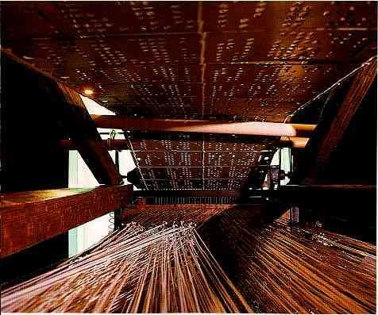
punched cards
In 1801 the Frenchman Joseph Marie Jacquard invented a power loom that could base its weave upon a pattern automatically read from punched wooden cards, held together in a long row by rope.
Descendants of these punched cards have been in use ever since.

Slide 9
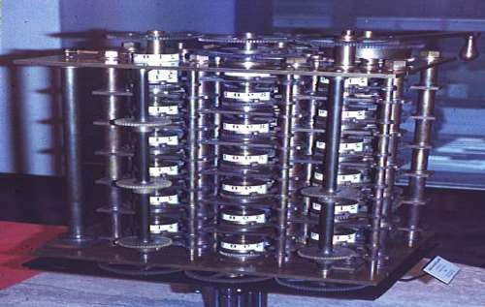
Babbage's Difference Engine
By 1822 the English mathematician Charles Babbage was proposing a steam driven calculating machine the size of a room, which he called the Difference Engine.
This machine would be able to compute tables of
numbers, such as logarithm tables.

Slide 10
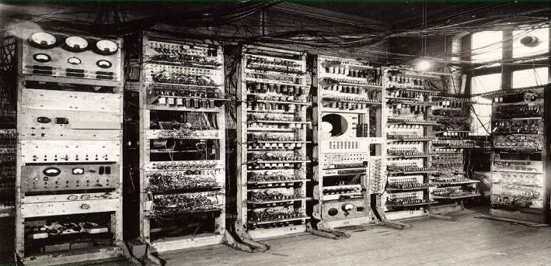
Mark 1
The MARK 1 computer was made in 1944.
This is a special step in computer history. Because MARK 1 is the first automatic digital computer world

Slide 11
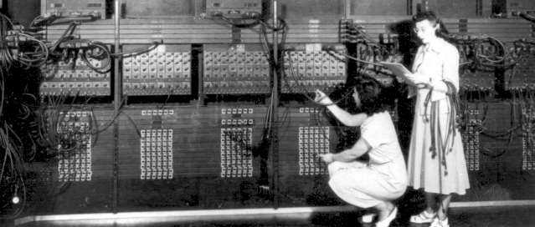
Eniac
The ENIAC(Electronic Numerical Integrator And Computer)
(1943 to 1945)
computer was very large in size
Its technology is Vacuum Tubes
It was the first general purpose computer

Slide 12
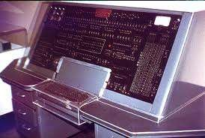
Univac
The UNIVAC(Universal Automatic Computer) computer was made in 1951.
This computer was faster and smaller than ENIAC and
Mark 1 computer.

Slide 13
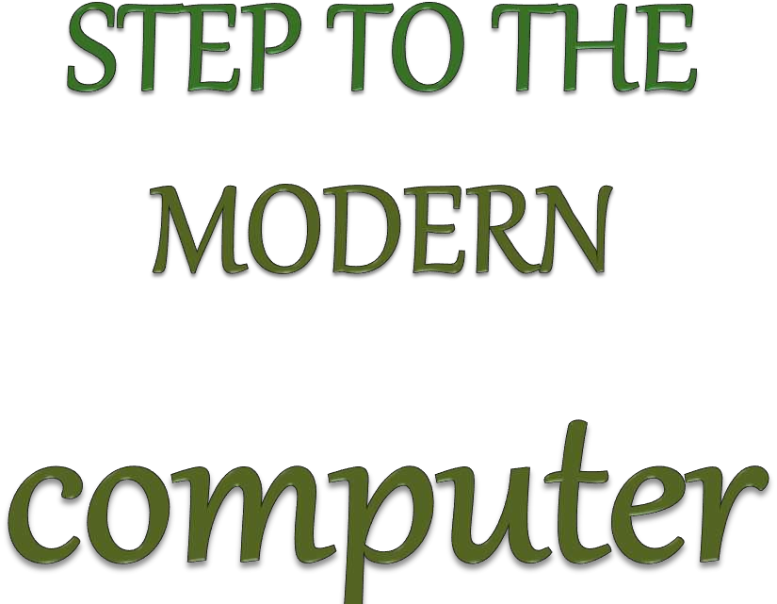

Slide 14
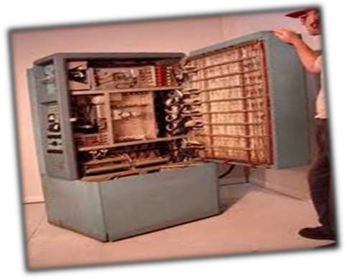
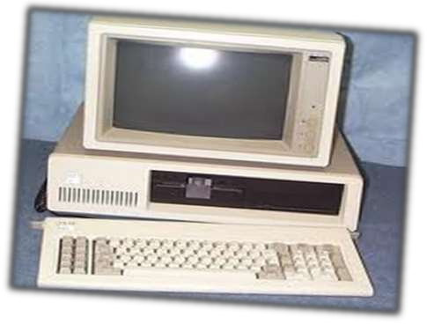
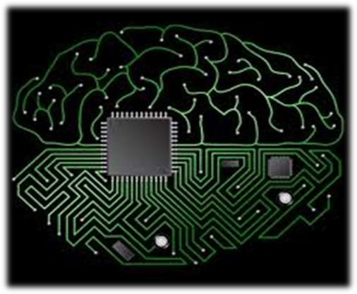
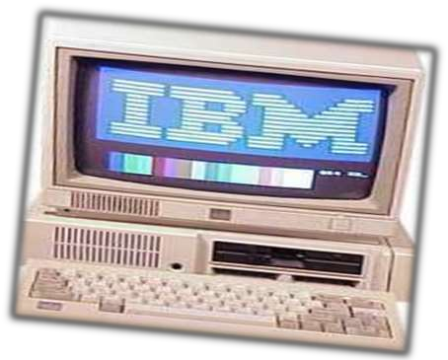
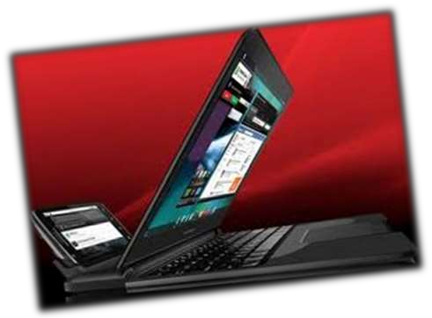

Slide 15
Computer
Generations
- Vacuum tubes
- Transistors
- IC(Integrated
Circuits)
- Micro Processor
- Artificial
intelligence
1st
2nd
3rd
Generation
Generation
Generation
4th
5th
Generation
Generation

Slide 16
First Generation Computers
(1940s-1956)
Generally, the computers built during the World War II
era are known as the first generation computers.
These are considered the first computers, and were
extremely different from the computers we see today.
They were designed for a specific task.
These primitive computers relied on vacuum tubes and magnetic drums.
The 1st generation computers were also extremely slow.

Slide 17
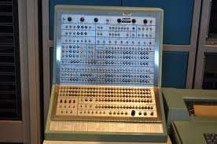
First Generation Computer

Slide 18
Second Generation Computers
(1956-1963)
The computers built in the 1950s and 1960s are
considered the 2nd generation computers.
These computers make use of the transistors invented by
Bell Telephone laboratories.
They had many of the same components as the modern- day computer
For instance, 2nd generation computers typically had a
printer, some sort of tape or disk storage, operating systems, stored programs, as well as some sort of memory.
These computers were also generally more reliable and were solid in design.

Slide 19
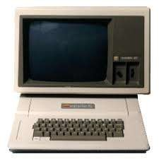
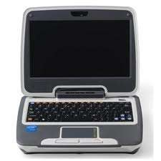
Second Generation Computers

Slide 20
Third Generation Computers
(1964-1971)
The 3rd Generation Computers were generally much smaller in size than the 2nd and 1st generation computers.
This is because these newer computers made us of integrated circuits and semiconductors
3rd generation computers also contained operating systems,
which acted as overseers to the performance of a computer and which allowed computers to run different programs at once.
Another function of operating systems is to make sure
everything is flowing smoothly inside the computer.
The 3rd generation computers made the transition from transistors to integrated circuits and from punch cards to electronic computer systems.

Slide 21
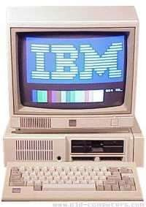
Third Generation Computer

Slide 22
Fourth Generation Computers
(1971-Present)
The 4th generation computers are marked by the usage of integrated circuits and microprocessors.
Computers became smaller and smaller, and their prices became lower and lower.
Millions of components could be placed onto a single silicon chip.
Computers became more efficient and more reliable, and they could perform more and more operations.
They began to catch the eye of the general public, and soon more sophisticated software and equipment were designed.
Networks became commonplace, and the whole world was connected by the Internet and by the World Wide Web.

Slide 23
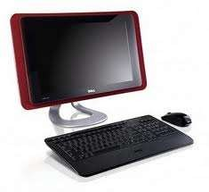
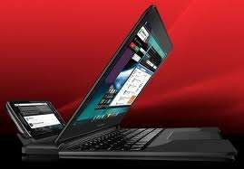
Fourth Generation Computers

Slide 24
Fifth Generation
(Present and Beyond)
Fifth generations computers are only in the minds of advance research scientists and being tested out in the laboratories.
These computers will be under Artificial
Intelligence(AI) Many of the operations which requires low human intelligence will be perfomed by these computers.
Parallel Processing is coming and showing the possibiliy that the power of many CPU's can be used side by side, Computers will be more powerful than thoes under central processing.
Advances in Super Conductor technology will greatly improve the speed of information traffic.

Slide 25
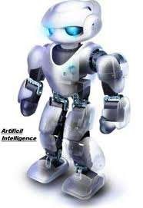
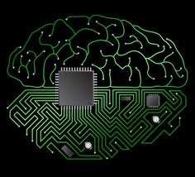
Fifth Generation
computer

Slide 26


